Slide 1


Database Migration
&
Validation Tool
reporter:Shen Xiyan WuZ iyou Yu Yuhan(leader)
Wang Jiahui Shen Entong Wang Xinyuan
time:2025/12/04

Slide 2



CONTENTS
01
Project Initialization and Base Framework Setup
02
Log and Metadata Base Framework
03
CLI Dual Core: Create and Validation
04
Migration Execution and Rollback
05
Status Query and Web Migration
06
Front-end pages and joint debugging and end-to-end verification and delivery
07

Slide 3

01
Project Initialization
&
Base Framework Setup

Slide 4

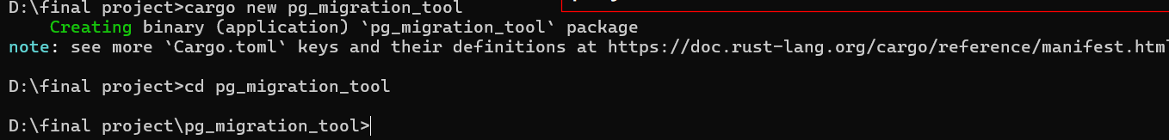
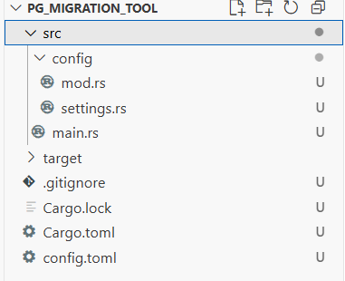


Create a project with cargo new
Command Execution
Project Structure
Verify the success of project initialization using the cargo build command. If the compilation completes without errors, it indicates that the project initialization is successful, laying the foundation for subsequent development.

Slide 5
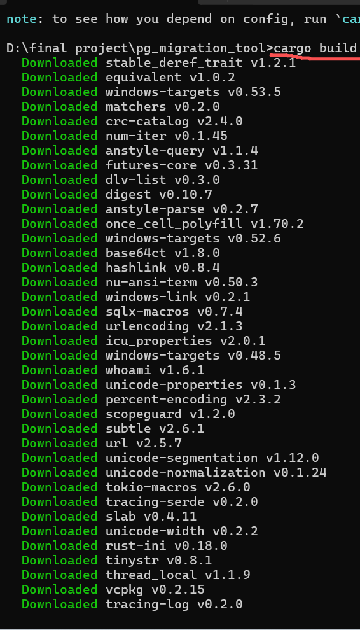
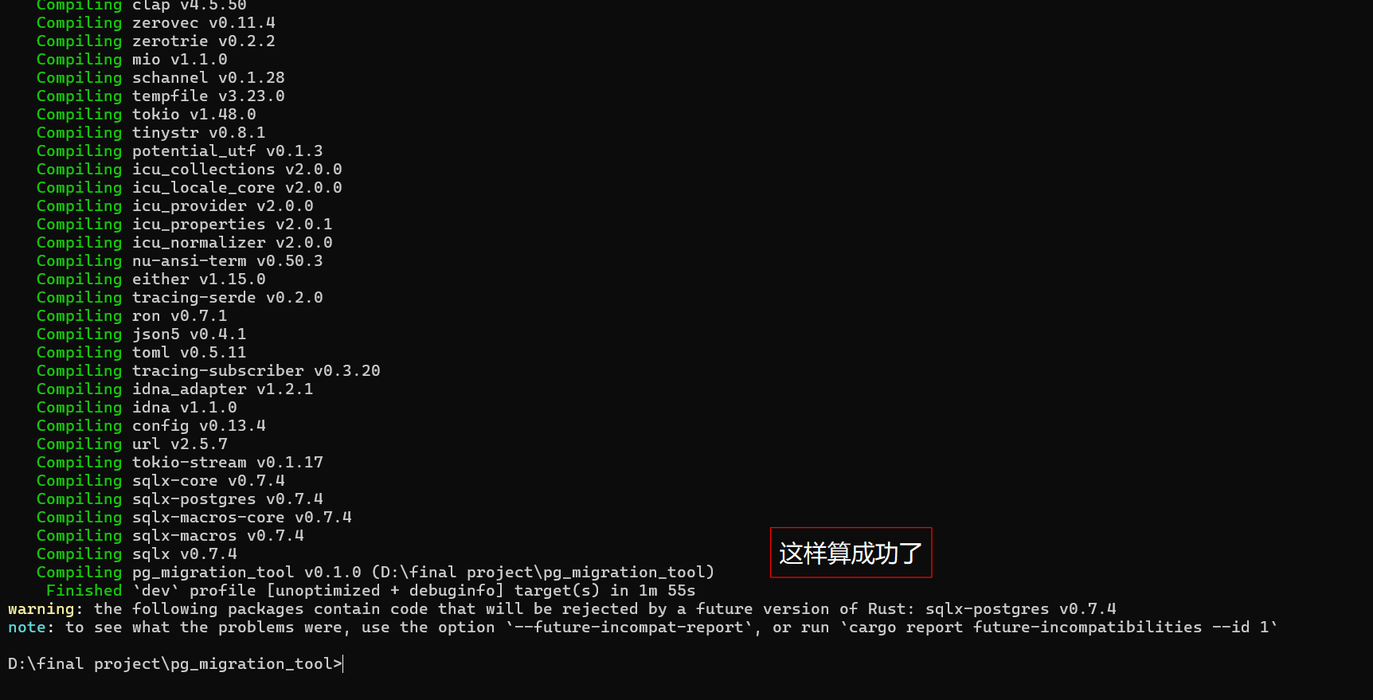
验证
Create a project with cargo new
Validation

Slide 6
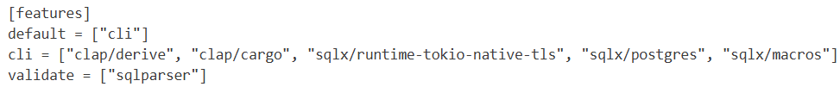

Set the default features to cli
Configure features
In Cargo.toml, configure the default features as cli, and place web-related dependencies under the web feature with it disabled by default. This can reduce the initial compilation time and optimize the development experience.

Slide 7
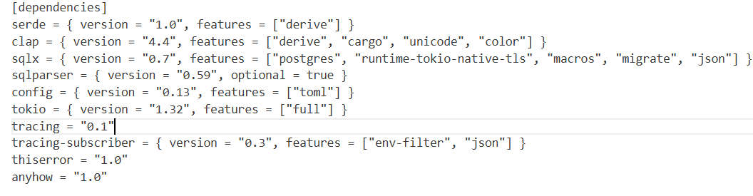
Introduce core dependencies in Cargo.toml
Add dependencies

Slide 8
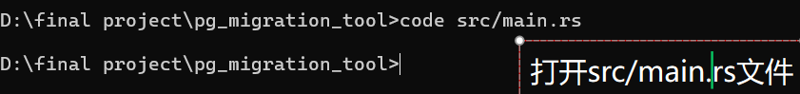

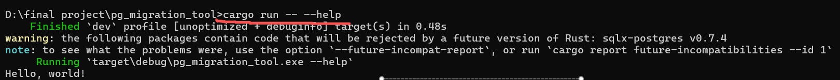
Smoke Test for Compilation Verification
Write test code
Check the output
Run and verify
Execute compilation
Run the cargo build command to verify whether the project can be compiled successfully.

Slide 9

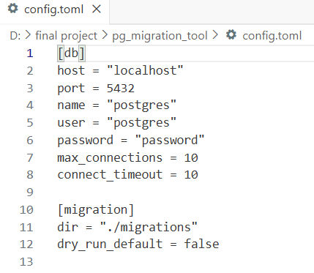
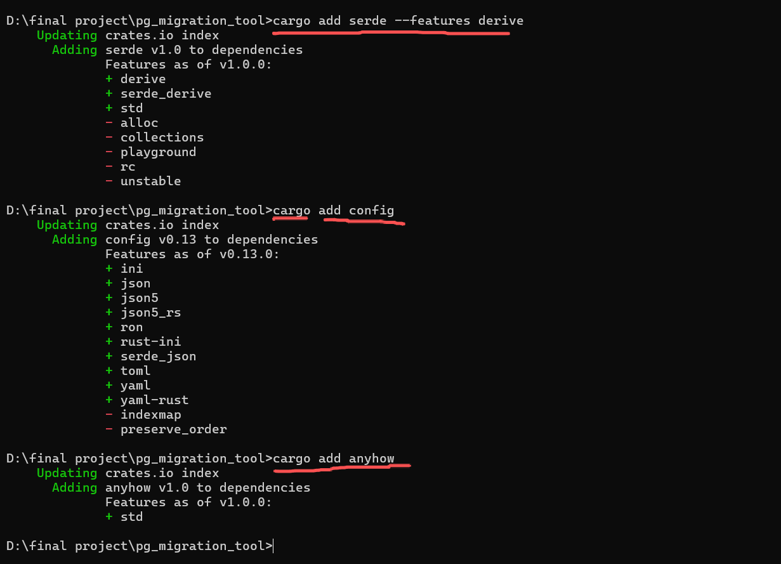
Define the Config struct
Struct definition
Serialization support
Field mapping

Slide 10
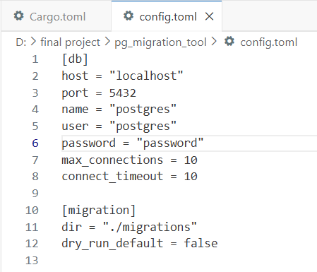
Write a config.toml template

Slide 11
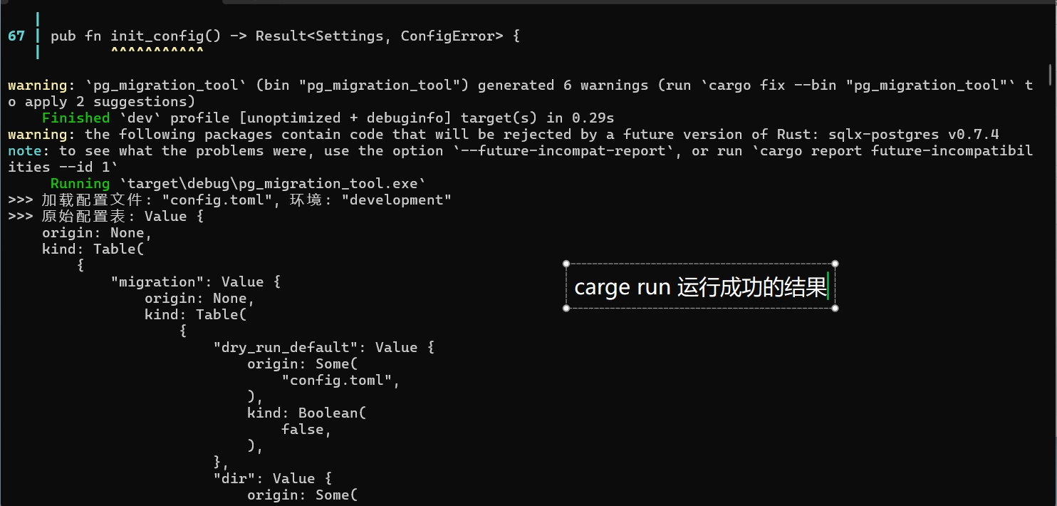
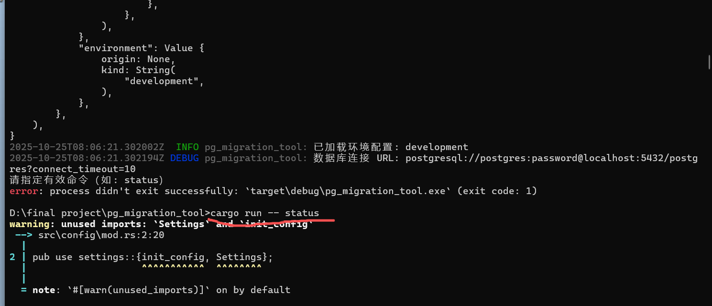
Implement the load_config function
Load the configuration

Slide 12
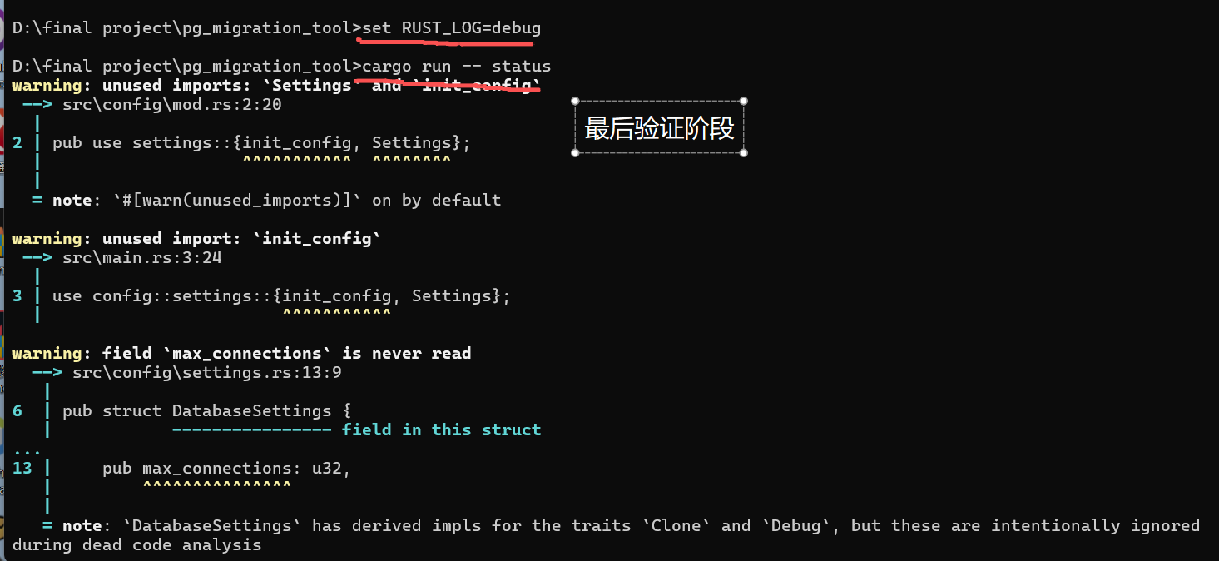
Verification
Final verification phase

Slide 13
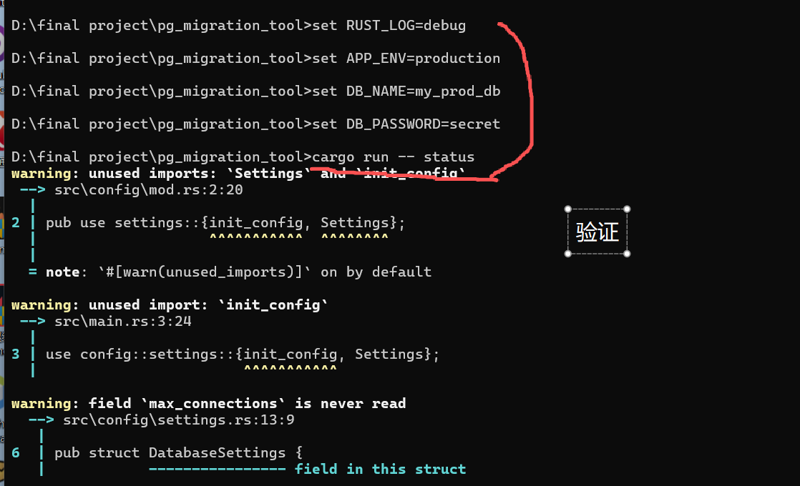
Verification
Final verification phase

Slide 14
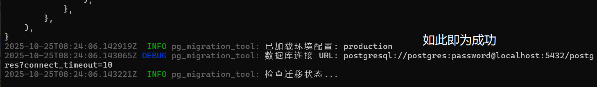
验证
This indicates success

Slide 15
02
Log and metadata base

Slide 16

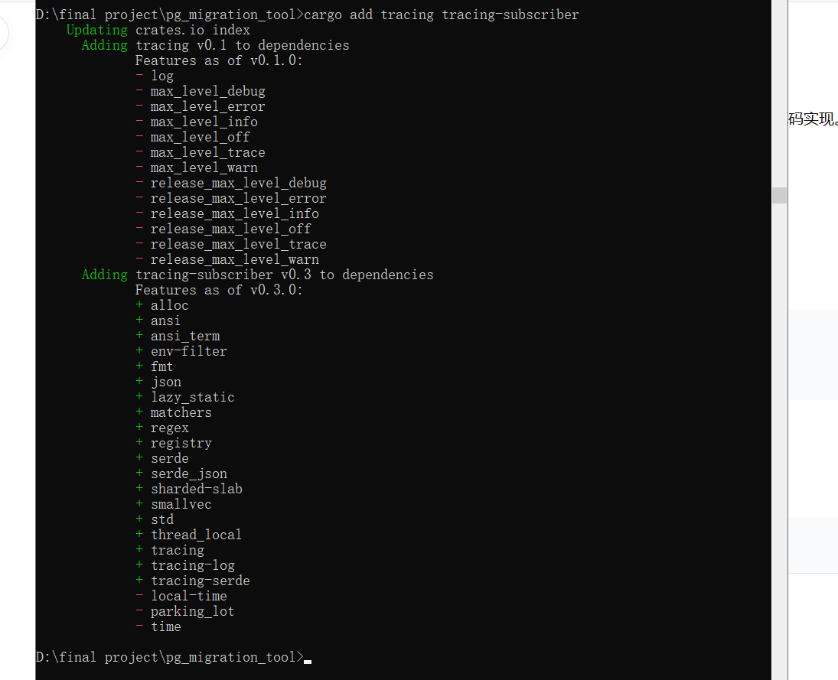
Add log dependencies
Operation: cargo add tracing-subscriber
Added tracing and tracing-subscriber dependencies

Slide 17
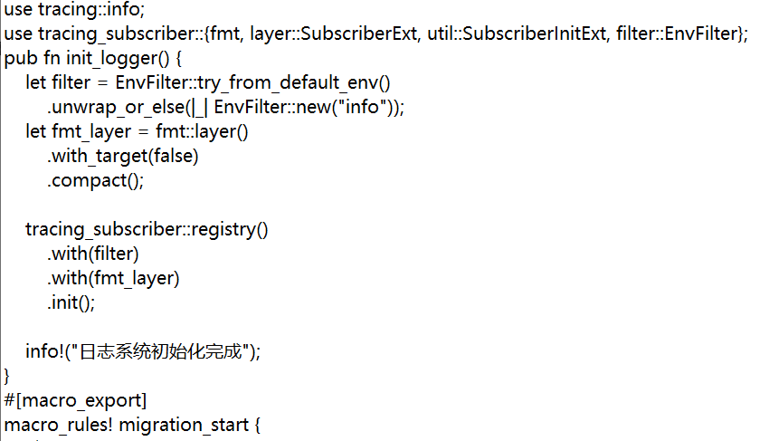
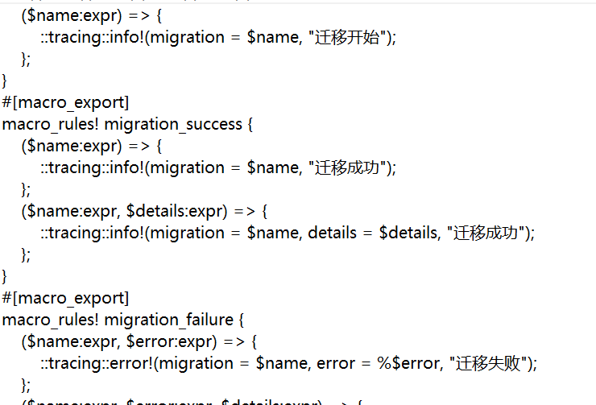
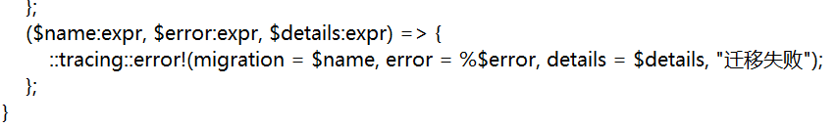
Create a log system module
Create a file:
src/logger.rs
The log system initialization function init_logger() has been implemented.
Three log macros were created
检查输出
检查终端输出，确认日志能够按照预期格式正确输出，无冗余信息。

Slide 18
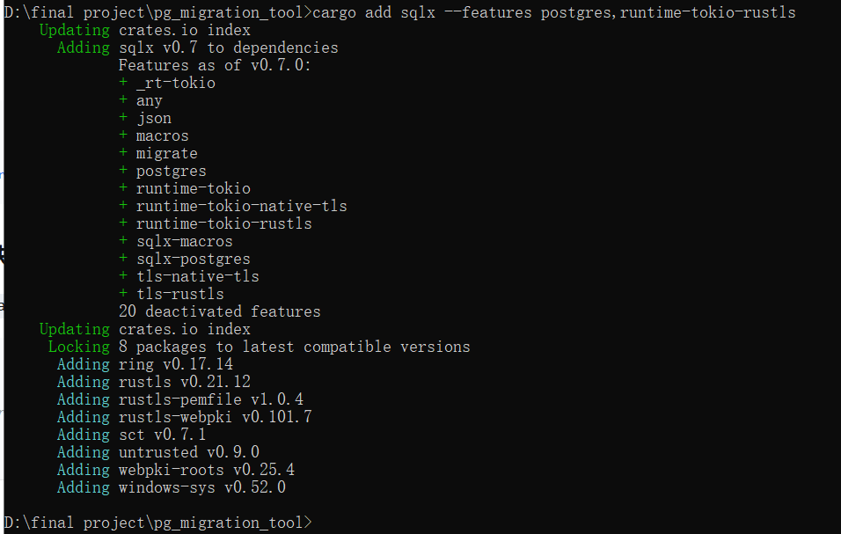

Add database dependencies
03
04
Operation: cargo add sqlx --features postgres,runtime -- tokio -- rustls
The SQLx asynchronous database tool has been added
状态字段
设计意图
引入status字段，支持失败可重试的场景，便于后续运维排查问题。
表结构设计旨在为迁移版本管理提供唯一真相源，满足项目对迁移过程的可追踪需求。

Slide 19
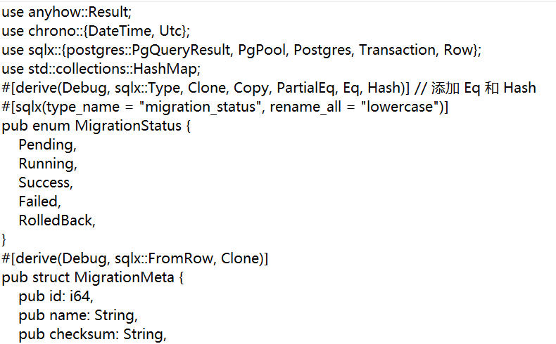

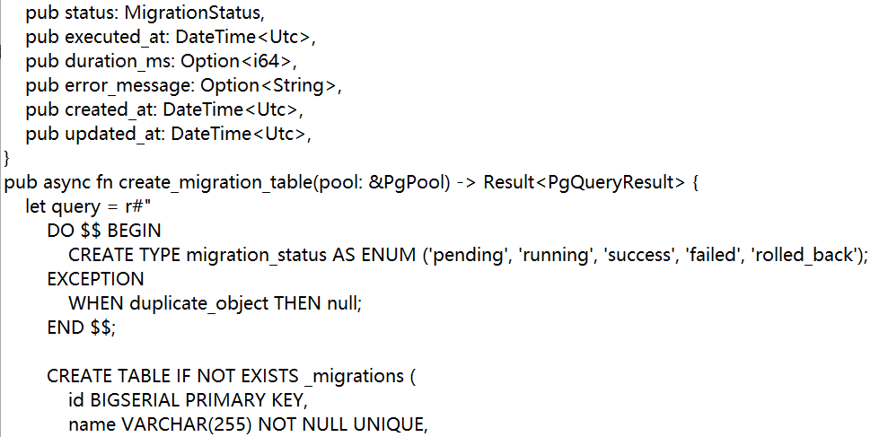
Create a metadata table module
File: src/migration_meta.rs
The MigrationStatus enumeration (Pending, Running, Success, Failed, RolledBack) was defined.
The MigrationMeta structure is defined to represent migration records

Slide 20
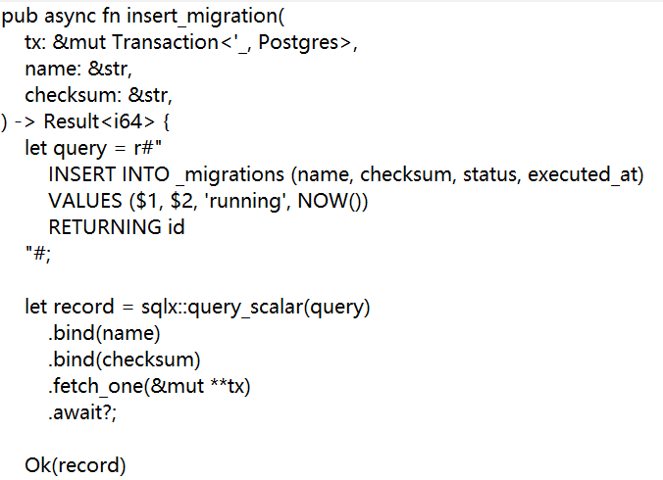
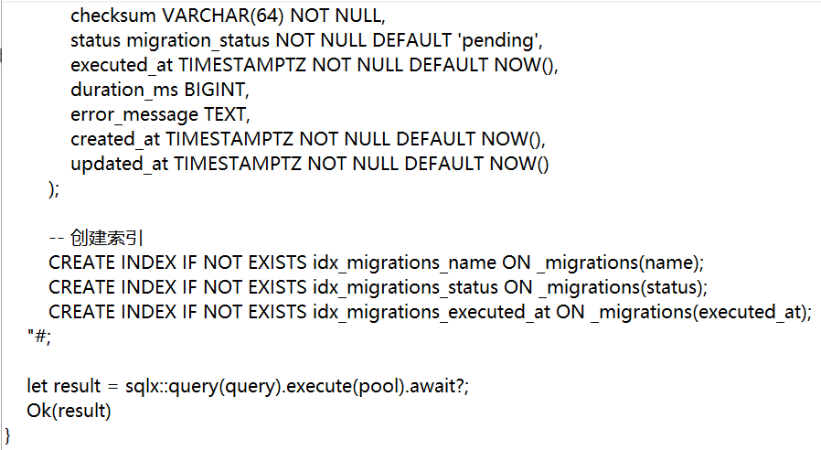
Create a metadata table module

Slide 21
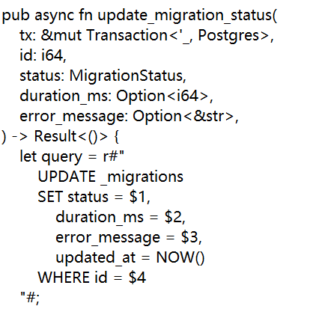
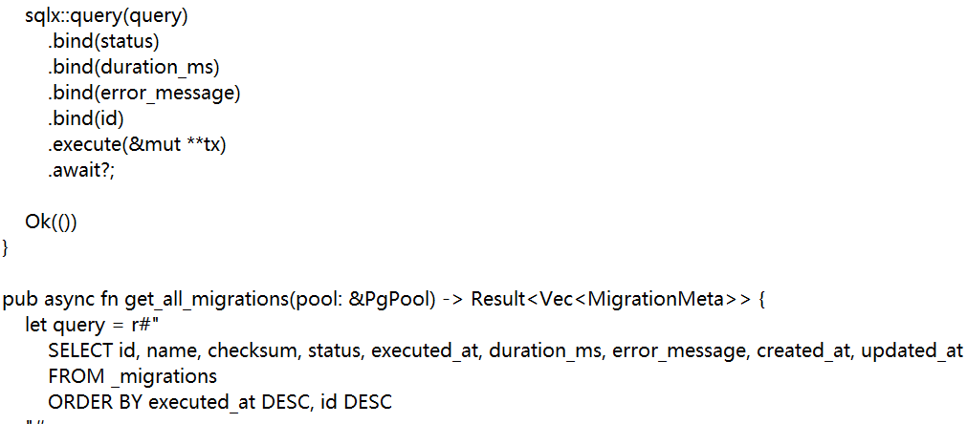
Create a metadata table module

Slide 22
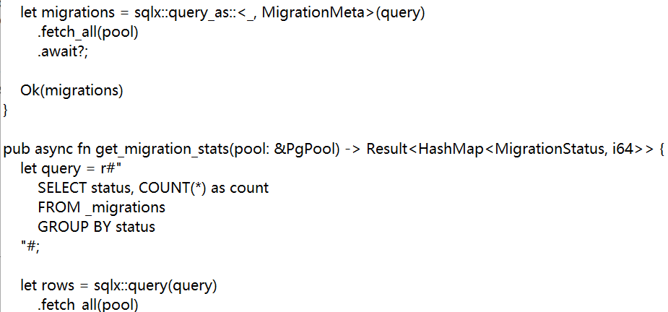
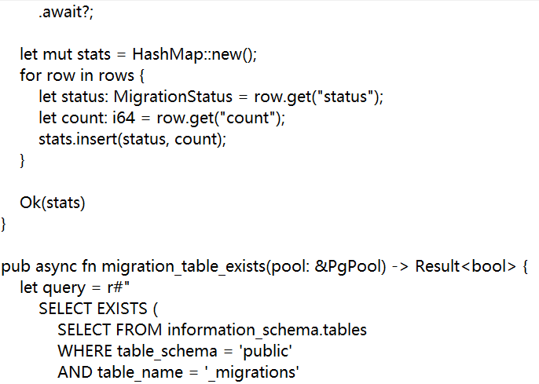
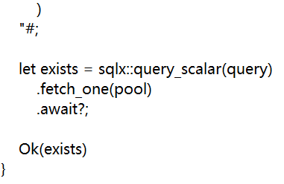
Create a metadata table module

Slide 23

Configuration module structure
Create a file
Code：
pub mod settings;
pub use settings::{init_config, Settings};
src/config/mod.rs
A module structure has been established
Prepare for configuration management

Slide 24

Library module export
pub mod config;
pub mod logger;
pub mod migration_meta;
pub use logger::init_logger;
pub use migration_meta::{
create_migration_table, get_all_migrations, get_migration_stats, insert_migration,
migration_table_exists, update_migration_status, MigrationMeta, MigrationStatus,
};
Create a file ： src/lib.rs
All modules have been declared
The commonly used types and functions have been re-exported
This enables external crates to conveniently use these functions

Slide 25
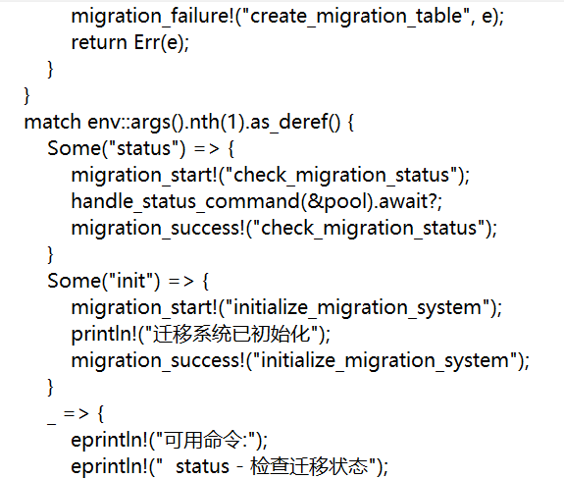
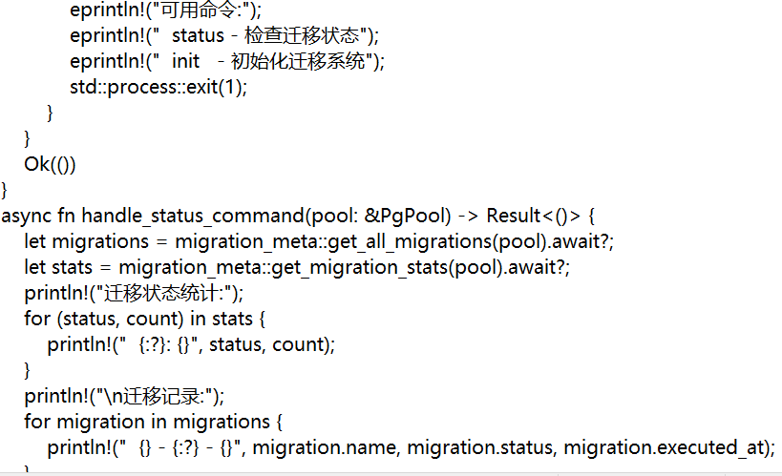
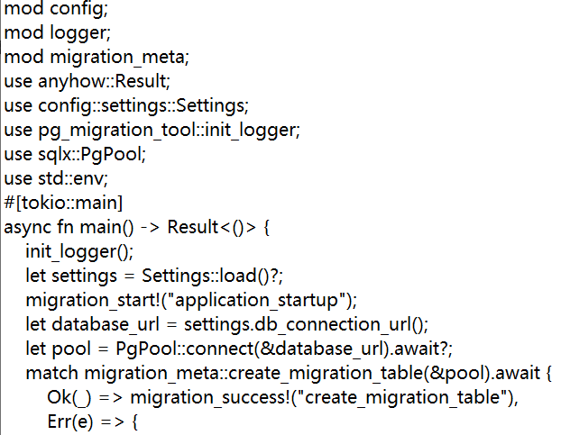
File: src/main.rs
Initialize the log system
Load the configuration, create a database connection pool, and create a migration metadata table
Handle command-line parameters (status, init commands)
Main program entry

Slide 26
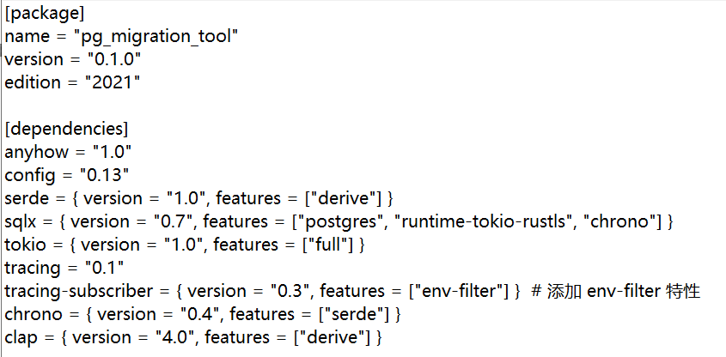
Update project configuration
File: Cargo.toml
All necessary dependencies have been added

Slide 27
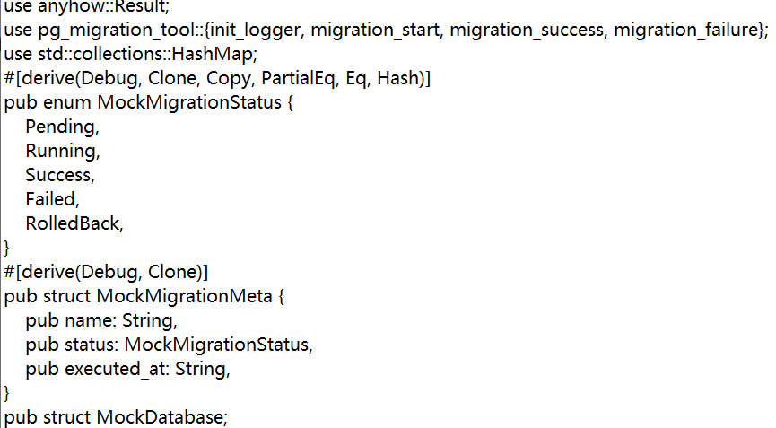
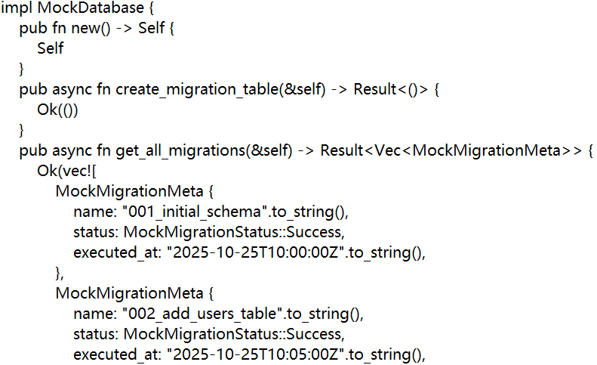
Verification procedure
Create a verification program module ：
src/verify_t3_t4.rs

Slide 28
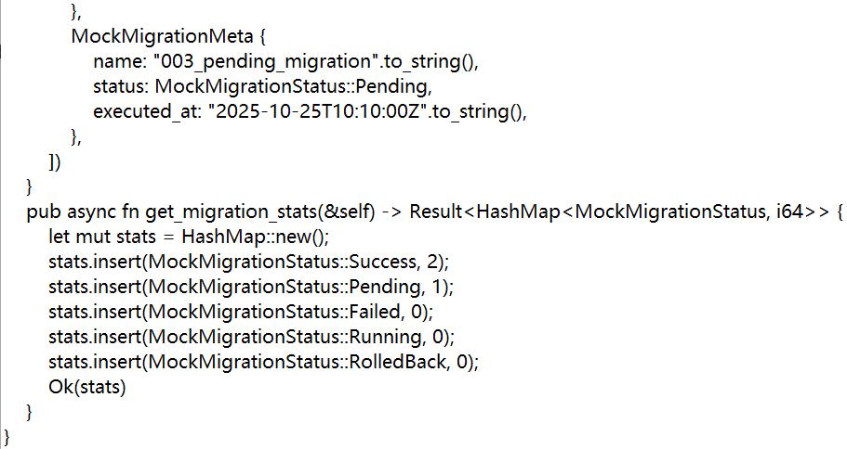
The T3 log function verification has been implemented
The functional verification of the T4 metadata table has been achieved

Slide 29
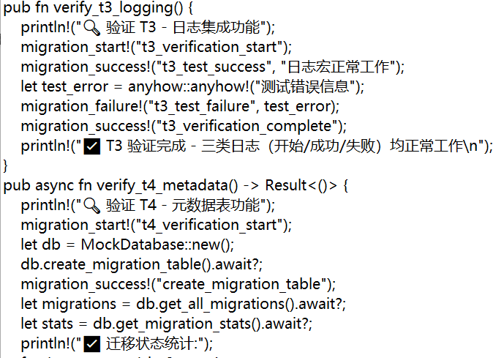
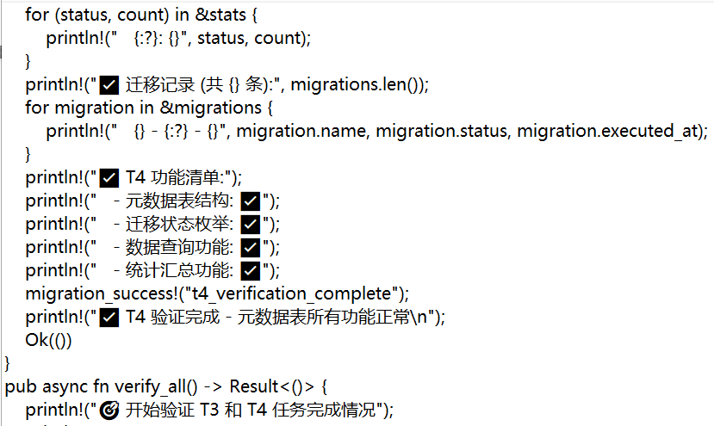
Verification procedure

Slide 30
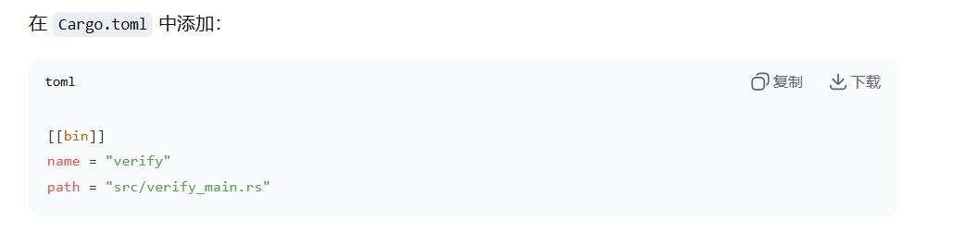
Configure binary targets
Operation: Add the [[bin]] configuration in Cargo.toml
An independent verification executable file has been created

Slide 31
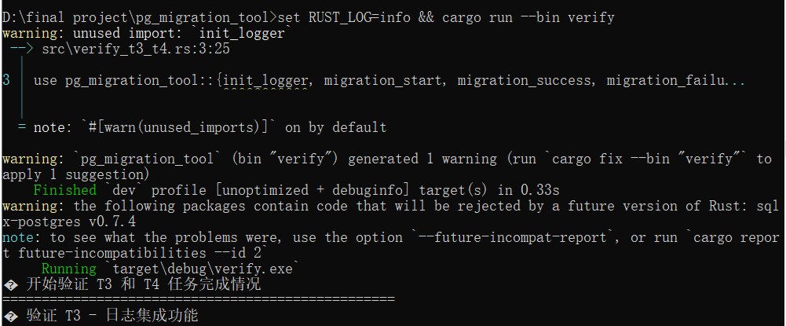
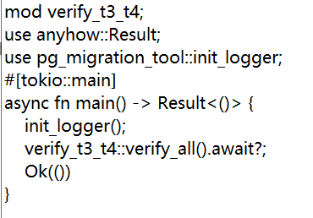
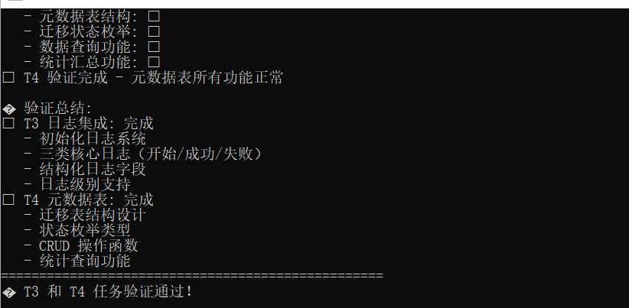
Verify the entry and results
The verification result shows：
Verify the program entry file ：
src/verify_main.rs

Slide 32
03
CLI Dual-Core:
Create and Verification

Slide 33

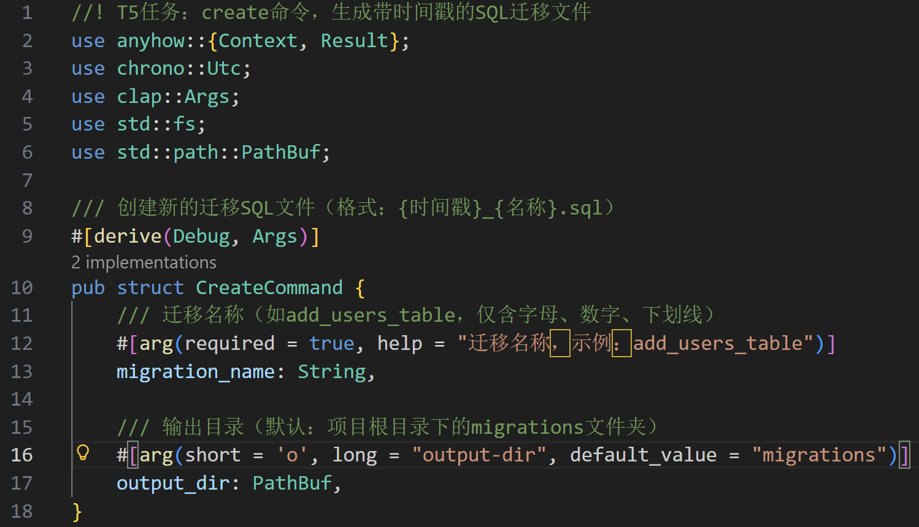
Define the Create.rs struct
CoreCore design of the struct (clap v4 command parameters)

Slide 34
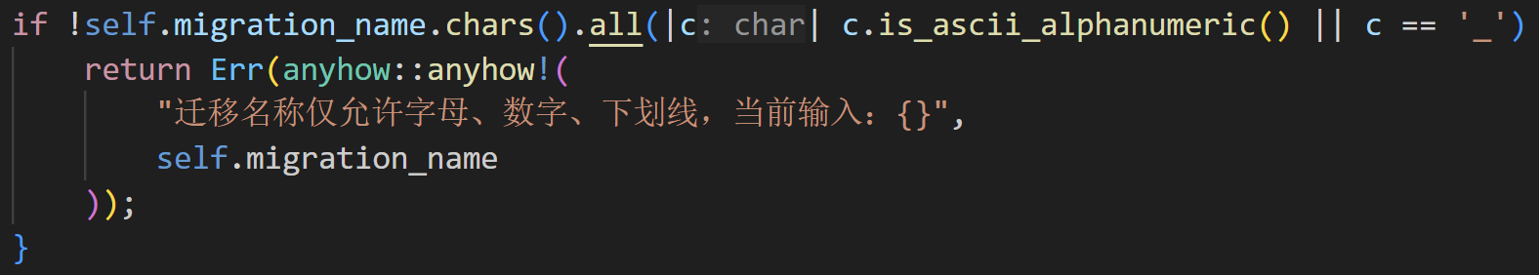
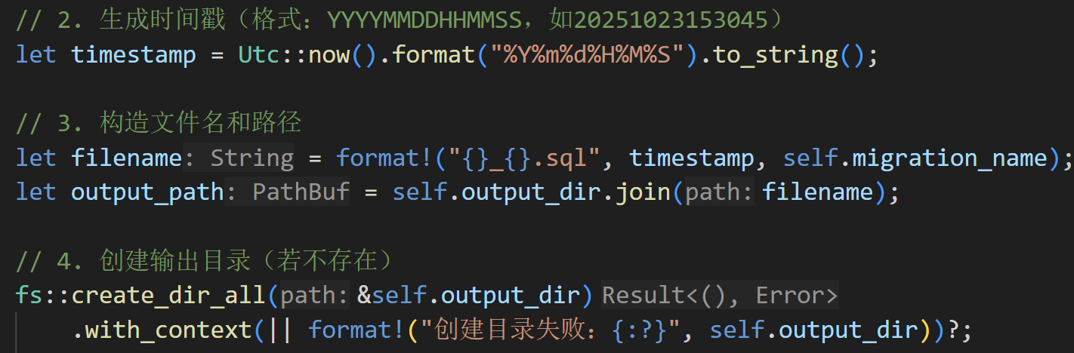
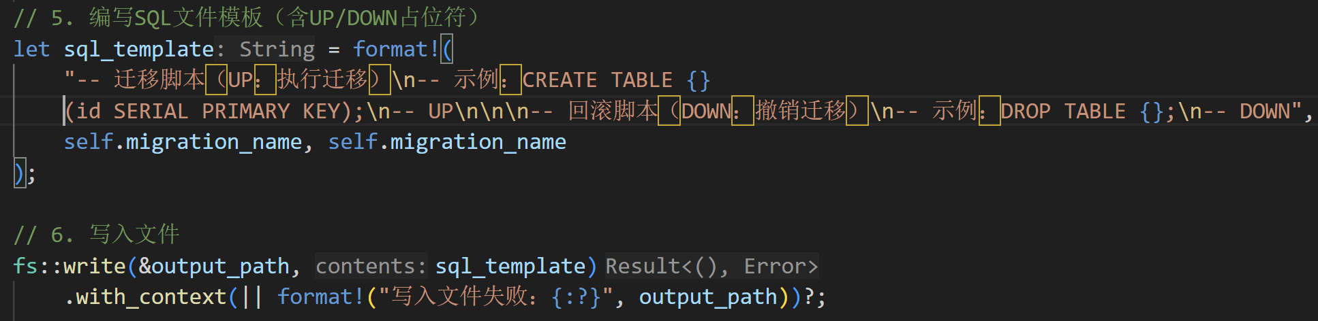
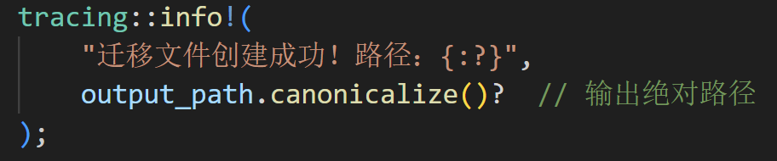
Core Logic (Core Steps of the run Method)
1.Name Validity Check
2.Timestamp and Path Generation
3.Built-in SQL Template Writing
4.Log Output

Slide 35

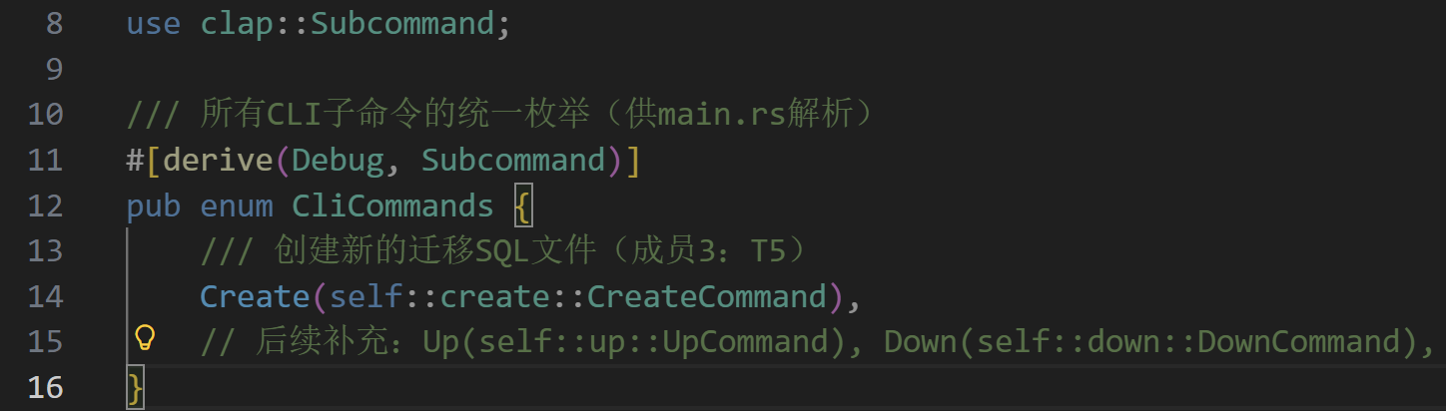
Project Integration: Command Registration and Executable Binary
Unified Subcommand Management (src/cli/mod.rs)

Slide 36
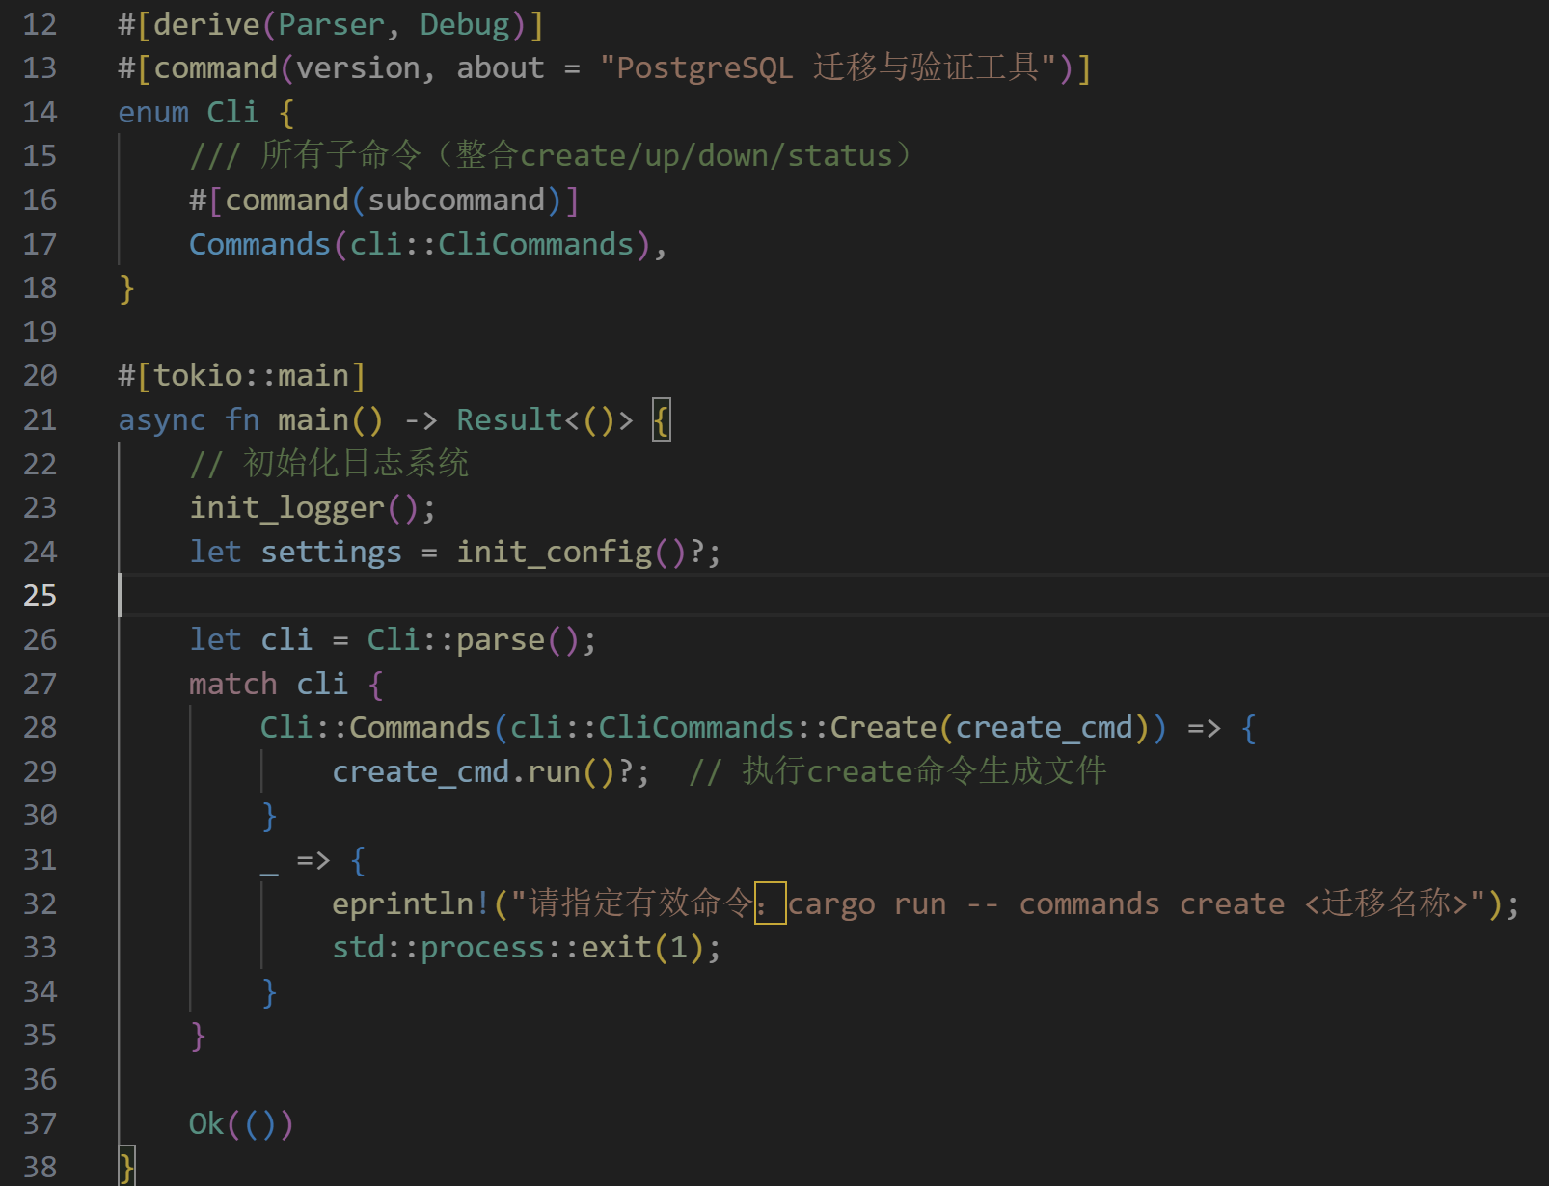
Entry Binding in main.rs

Slide 37


Configuration for Executable Binary (Cargo.toml)

Slide 38



Execution Effect and User Experience
Execution Effect and User Experience
Verification succeeded

Slide 39


Example of Generated File
1.Path
2.Template Content

Slide 40



Core Dependencies and Interface Design
1. Key Dependencies (Cargo.toml)
Core Interface
1.Error Enumeration
2.Verify options

Slide 41




Core Function Implementation
01
SQL Syntax Validation
Core Logic:
SQL Text →
Parse with PostgreSqlDialect →
Generate AST (Abstract Syntax Tree) →
Capture error if parsing fails and return ValidateError::SyntaxError
03

Slide 42

02
High-Risk Operation Interception
Interception Scope:
DROP TABLE：Delete table
DELETE FROM without WHERE：Full-table deletion
TRUNCATE TABLE：Truncate table
03

Slide 43

Reusable Validation Function
Core Function Signature
The function is encapsulated under the SqlValidator struct and invoked via Self::, resulting in a more structured design.
validate_file automatically handles file reading and returns SyntaxError (including file reading error information) on failure.
Syntax validation is directly bound to PostgreSqlDialect without the need for additional parameters, adapting to the target database.

Slide 44
Test Case Coverage
Test Scenario | Corresponding Test Function | Expected Result
SQL with syntax error (missing parenthesis) | test_validate_syntax_error | Returns SyntaxError (containing "expected" or ")")
Normal SQL (CREATE TABLE) | test_validate_normal_sql | Validation passed (Ok(()))
High-risk operation (DROP TABLE) | test_validate_high_risk_drop | Returns HighRiskOp("DROP TABLE")
High-risk operation (DELETE without WHERE) | test_validate_high_risk_delete_no_where | Returns HighRiskOp("DELETE FROM (no WHERE clause, may delete entire table)")
High-risk operation (TRUNCATE TABLE) | (Extensible, code already supports detection) | Returns HighRiskOp("TRUNCATE TABLE")
Allowed specified high-risk operation (DROP TABLE) | test_validate_allowed_high_risk | Validation passed (Ok(()))
Disabled high-risk detection | test_validate_disabled_high_risk | High-risk operation allowed (Ok(()))
DELETE with WHERE clause (safe operation) | test_validate_delete_with_where | Validation passed (Ok(()))

Slide 45



7 Tests

Slide 46


All 7 core scenario tests have passed, indicating that:
The syntax validation module can accurately identify SQL syntax errors;
The high-risk operation interception logic can effectively block risky operations such as DROP TABLE and DELETE without WHERE;
Configuration items (allowing high-risk operations, disabling high-risk detection) can take effect as expected, meeting the flexible needs of different environments.
Usage Effect
Verification succeeded

Slide 47
04
Migration Execution and Rollback

Slide 48


Definition of Up and Parameters
Structure Definition
Parameter Analysis

Slide 49


Dry Run Transaction Simulation
Transaction Simulation
预检机制
Start a transaction within the same database connection, execute the SQL statements to be migrated in order, and if any statement fails, immediately roll back and return a detailed error.
Dryn机制让开发者在上迁前即可发现语法或约束问题，相当于为迁移脚本提供沙箱验证。
Verify the effect

Slide 50



Official Migration and Metadata Storage
Transaction Binding
Pre-inspection and Execution
First, call dry_run for a pre-check. After passing, execute the same SQL formally using the same connection and commit the transaction to ensure atomicity.
Complete audit trail
Metadata record
Immediately after a successful migration, call the insert_record implemented by T4 to write version, name, status=success, and executed_at into the _migrations table.

Slide 51


Define DownCommand and steps
Structure Definition
Add the DownCommand struct in src/cli/down.rs, with steps defaulting to 1, allowing users to specify the rollback step count.
Check recent records

Slide 52


Reverse SQL Generation Rules
Data Backup
Before officially executing the reverse SQL, first call backup_table_to_csv to export all the data from the table to be deleted into a CSV file.
Reverse SQL Generation

Slide 53


CSV Backup and Transaction Rollback
Rollback execution
Transaction Security
If the reverse SQL fails,the CSV file will also be automatically cleaned up to avoid leaving a dirty backup.。
Status Tracking
Record the status and time of rollback operations through metadata tables to ensure that each rollback has a complete audit trail.
Lifecycle Management
Implement a bidirectional traceable migration lifecycle management to ensure that during multiple down/up combinations, the metadata table always accurately reflects the current database version.

Slide 54


UP failure interception demonstration
01
Prepare the script
Prepare a create table script with grammatical errors for testing the failure interception function of the up command.
Execute command
02
Execute `cargo run -- up --config config.toml` to verify whether the DryRun phase can correctly report errors and roll back.
03
Test Results
Check the database status, ensure no changes have occurred, and verify the effectiveness of the pre-check mechanism.

Slide 55


Down rollback backup demonstration
Perform rollback
Execute 'cargo run -- down --steps 1'. The system first exports the data from the test table to a CSV file, and then executes DROP TABLE.
生产适用性
Status Tracking
Check the _migrations table to ensure the status accurately reflects the rollback time and verify the reliability of the down command.
证明down命令在可恢复与可审计两方面均达到生产要求，为持续集成中的自动回滚场景提供可靠原语。

Slide 56


Down rollback backup demonstration
生产适用性
证明down命令在可恢复与可审计两方面均达到生产要求，为持续集成中的自动回滚场景提供可靠原语。

Slide 57
05
Status Query and Web Migration

Slide 58


Define the StatusCommand structure
Design of the StatusCommand Structure
• Simple config_path field configuration
• Maintain a consistent style with other CLI commands
• Zero-parameter design reduces the learning curve
Core query logic
• Connect to the database and read the migrations table
• Sort in descending order by version number
• Automatically calculate migration status
• Support for identifying applied/pending execution status

Slide 59

Console four-column table output
Four column table output design
Version - Unique identifier
• Migration Name - Descriptive Name
• Status - Visual icon
• Execution time (Applied At) - timestamp
Status visualization icon
✅ Applied - Successfully executed
⏳ Pending - waiting for execution
❌ Failed - Execution failed
- Not executed - No time record
标记状态
通过集合对比，为每个版本打上已应用或待执行标签，直观展示迁移进度。

Slide 60




Actix web service startup
Bind port 8080 service
Unified JSON response format
• Static file service support
Cross domain request processing
RESTful API Design
GET/app/migrations - Get migration status list
POST/app/migrations/up - Perform migration operations
Unified error handling mechanism
服务启动

Slide 61


GET/API/migrations reuse state logic
1. Start the web service
2. Call GET/app/migrations
3. Verify JSON response format
4. Data consistency check
Response data format
• success: whether the operation was successful
• data: Migration record array
• message: Status message

Slide 62



Slide 63

Front and rear data streams
🔗 Architectural Design
Front end: HTML+JavaScript
Backend: Rust+Actix web
Communication: RESTful API+JSON
Data flow: Front end → API → Back end → Database
接收参数
返回结果
POST /api/migrations/up接口接收JSON配置路径，解析后调用T7的up迁移内核。
将最终成功或失败原因封装为统一响应，包括executed_versions与error_detail字段。
执行迁移
测试集编写
执行dry run、正式执行、元数据记录完整链路，确保迁移操作的安全性和可靠性。
提供pg_migration_api.postman_collection.json，覆盖参数、预期响应、断言，方便使用Postman进行接口测试。

Slide 64


Front and rear data streams
🛠️ Backend technology stack
• Web framework: Actix web
• Routing configuration: manual registration
• Data serialization: Serde JSON
• Error handling: Result type
接收参数
返回结果
POST /api/migrations/up接口接收JSON配置路径，解析后调用T7的up迁移内核。
将最终成功或失败原因封装为统一响应，包括executed_versions与error_detail字段。
执行迁移
测试集编写
执行dry run、正式执行、元数据记录完整链路，确保迁移操作的安全性和可靠性。
提供pg_migration_api.postman_collection.json，覆盖参数、预期响应、断言，方便使用Postman进行接口测试。

Slide 65

Front and rear data streams
🎨 Front-end design
• Native HTML/CSS/JavaScript
• Responsive table design
Real time status display
• User interaction buttons
接收参数
返回结果
POST /api/migrations/up接口接收JSON配置路径，解析后调用T7的up迁移内核。
将最终成功或失败原因封装为统一响应，包括executed_versions与error_detail字段。
执行迁移
测试集编写
执行dry run、正式执行、元数据记录完整链路，确保迁移操作的安全性和可靠性。
提供pg_migration_api.postman_collection.json，覆盖参数、预期响应、断言，方便使用Postman进行接口测试。

Slide 66

Front and rear data streams
✅ Connection verification
Curl testing API usability
Browser developer tool monitoring
Real time request response logs
• Error handling and downgrade
接收参数
返回结果
POST /api/migrations/up接口接收JSON配置路径，解析后调用T7的up迁移内核。
将最终成功或失败原因封装为统一响应，包括executed_versions与error_detail字段。
执行迁移
测试集编写
执行dry run、正式执行、元数据记录完整链路，确保迁移操作的安全性和可靠性。
提供pg_migration_api.postman_collection.json，覆盖参数、预期响应、断言，方便使用Postman进行接口测试。

Slide 67


Slide 68

Front and rear data streams
🚀 operating procedure
1. Page loading automatically retrieves data
2. Display migration status table
3. User clicks to execute migration
4. Backend processing and returning results
5. Front end refresh displays new status
接收参数
返回结果
POST /api/migrations/up接口接收JSON配置路径，解析后调用T7的up迁移内核。
将最终成功或失败原因封装为统一响应，包括executed_versions与error_detail字段。
执行迁移
测试集编写
执行dry run、正式执行、元数据记录完整链路，确保迁移操作的安全性和可靠性。
提供pg_migration_api.postman_collection.json，覆盖参数、预期响应、断言，方便使用Postman进行接口测试。

Slide 69


接收参数
返回结果
POST /api/migrations/up接口接收JSON配置路径，解析后调用T7的up迁移内核。
将最终成功或失败原因封装为统一响应，包括executed_versions与error_detail字段。
执行迁移
测试集编写
执行dry run、正式执行、元数据记录完整链路，确保迁移操作的安全性和可靠性。
提供pg_migration_api.postman_collection.json，覆盖参数、预期响应、断言，方便使用Postman进行接口测试。

Slide 70

HTML List Page Structure Design

Slide 71
06
Front-end pages and joint debugging and end-to-end verification and delivery

Slide 72



Static file routing mounts
Routing configuration
Configure static file routing in Actix-web service to map local static directories to /static prefixes to facilitate browsers to directly access HTML and JS files.

Slide 73


Cross-domain response header processing
Cross-domain issues
Add Access-Control-Allow-Origin:* to the response header to allow local file protocol or cross-port debugging.
Workaround
Ensure that the front-end and back-end joint debugging will not be blocked by the browser due to cross-domain issues.

Slide 74



test_full_flow.sh scripting
01
02
03
Script orchestration
Key Point Verification
Test Report
Write test_full_flow.sh script and call the create, up, status, and down commands in order, and assert success through the exit code at each step.
Use cURL to access the status API to confirm key nodes such as SQL generation, table creation success, and disappearance after rollback.
After the script is executed, the test report .md is automatically generated, including command, expectation, actual, and screenshot columns, and the evidence is solidified in the form of a table.

Slide 75



Run the test results

Slide 76
THANK YOU FOR WATCHING

